Slide 1


Organizational Behavior
(MGT-502)
Lecture-22

Slide 2
Summary of
Lecture-21

Slide 3



External Organizational
Communication
Public
Relations
Marketing and
Advertising
Surveys
Lobbying
Notes:
8

Slide 4

Functions of Communication
Control
Motivation
Information
Emotional
Expression

Slide 5
What Will Your Audience Remember?
More
How Much is
Remembered
As time passes, your audience remembers less.
Less
How Much Time Passes
More

Slide 6
Communication
I didn’t say that I
didn’t say it. I said
that I didn’t say that
I said it. I want to
make that very clear.
-- G. Romney
Notes:
This material is found in the beginning of the chapter.

Slide 7
Today’s Topics

Slide 8
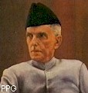
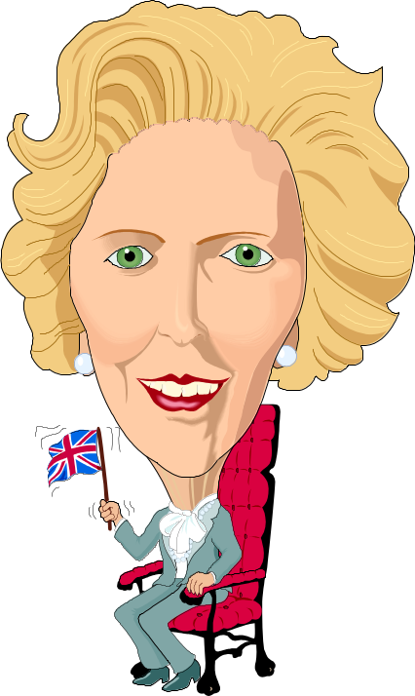
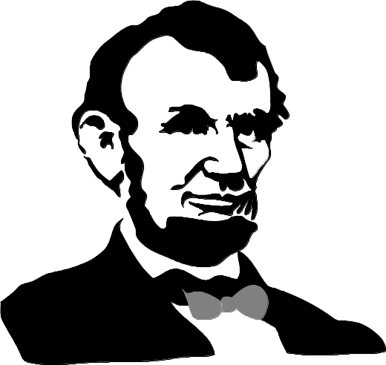
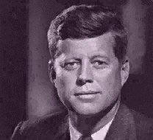
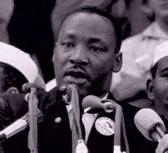
Leadership

Slide 9
“All Leaders
are Managers….
But not all Managers
are Leaders”
True or False?

Slide 10
What Is Leadership?
No universally agreed-upon definition.
Involves influencing the attitudes, beliefs, behaviors, and feelings of other people.
Most people agree that it is an important topic!

Slide 11

Leadership
An interpersonal process in which influence is exercised in a social system for the achievement of organizational goals by others

Slide 12
Group
Phenomenon
Influence
and Persuasion
The Basics
of Leadership
Some Form
of Hierarchy
Goal Directed
Behavior
Notes:
3

Slide 13
Leadership
Leader
  someone who can influence others and who has managerial authority
Leadership
  process of influencing a group toward the achievement of goals

Slide 14

Leadership
The process of influencing an organized group toward accomplishing its goals

Slide 15
Leadership Is a Process, Not a Position
Leader
Followers
Leadership
Situation

Slide 16


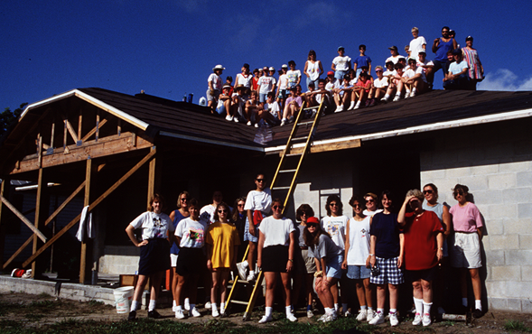
Leadership
The ability to get things done through people.

Slide 17
Myths That Hinder Leadership Development
Good leadership is all common sense.
Leaders are born, not made.
The only school you learn leadership from is the school of hard knocks.

Slide 18
Conventional Wisdom About Leadership
People who are tall and athletic make better leaders.
Smarter people make better leaders.
Leaders who are stable and predictable are more effective.

Slide 19
Research Findings About Leadership
People who are tall and athletic do not necessarily make better leaders.
In some situations, smarter leaders consistently performed less well than those who were less smart.
The most effective leaders use different bases of power to meet situational demands.

Slide 20
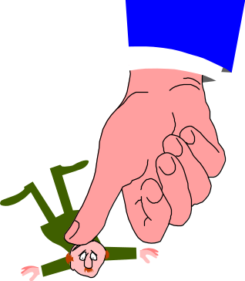
Why Study Leadership?
Understanding leadership helps organizations:
  select the right people for leadership positions
  train people in leadership positions to improve
Who benefits?
  leaders
  followers
  organizations

Slide 21
Leaders & Managers

Slide 22
Distinctions Between Managers and Leaders
Leaders
  Innovate
  Develop
  Inspire
  Take the long-term view
  Ask what and why
  Originate
  Challenge the status quo.
Managers
  Administer
  Maintain
  Control
  Have a short-term view
  Ask how and when
  Accept the status quo

Slide 23

Management Process
Reduces uncertainty
Provides stability
Components
  Planning & budgeting
  Organizing and staffing
  Controlling & problem
  solving
Manager –
an advocate for stability and the
status quo
Notes:
4

Slide 24

Leadership Process
Creates uncertainty
Creates change
Components
  Setting organizational direction
  Aligning people with the direction via communication
  Motivating people to action
    Empowerment
    Gratify needs
Leader –
an advocate for
change and new approaches to
problems
Notes:
5

Slide 25

Leadership vs Management
Leadership & management are distinct, yet complementary systems of action
Effective leadership
produces useful change
Effective management controls complexity
Effective leadership + good management = healthy organizations
Notes:
3

Slide 26
Leadership & Followership
Leadership - the process of guiding & directing the behavior of people in the work environment
Formal leadership - the officially sanctioned leader-ship based on the authority of a formal position
Informal leadership - the unofficial leadership accorded to a person by other members of the organization
Followership - the process of being guided & directed by a leader in the work environment
Notes:
2

Slide 27
An Interactional Framework For Analyzing Leadership
Leader
Personality
Position
Expertise,
Etc.
Followers
Leadership
Situation
Values
Norms
Cohesiveness,
Etc.
Task
Stress
Environment,
Etc.

Slide 28
Leader Traits That Influence the Leadership Process
Personality
Position
Experience

Slide 29
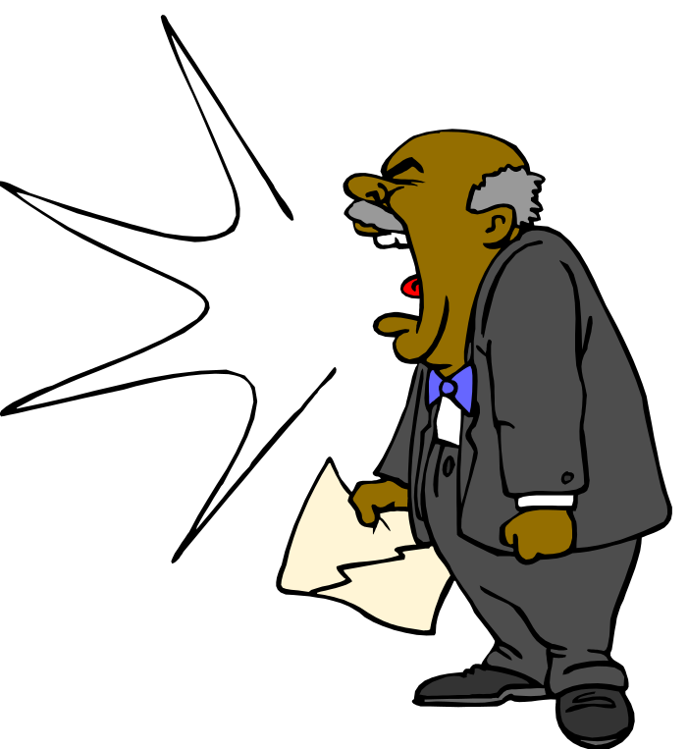

Leaders and power
Power is the capacity of a leader to influence work actions or decisions.
Five sources of power:
      Legitimate power
      Coercive power
      Reward power
      Expert power
      Referent power

Slide 30
Sources of Leader Power
Furniture and office arrangements
Prominently displayed symbols
Appearances of title and authority
Choice of clothing
Presence or absence of crisis

Slide 31
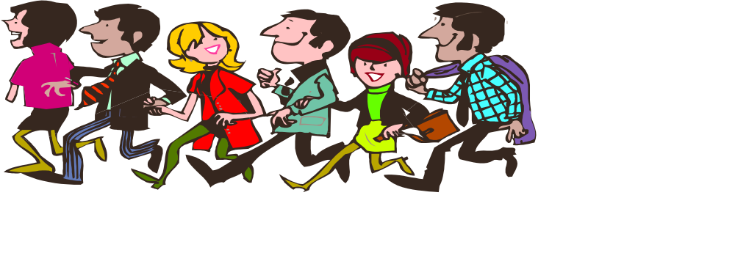
Follower Traits That Influence the Leadership Process
Expectations
Personality
Maturity
Competency levels

Slide 32
Follower Traits That Influence the Leadership Process, continued
Motivation
Number of followers
Trust and confidence

Slide 33
Followers Can Make a Bigger Contribution By:
Being more proactive in solving organizational problems.
Becoming better skilled at “influencing upward.”
Staying flexible and open to opportunities.

Slide 34
How Leaders Interact with Followers
Create environments where followers’ innovations and creative contributions are welcome.
Encourage growth and development in followers.
Interested in the big picture of followers’ work.

Slide 35

How Leaders Interact with Followers, continued
Motivate followers through more personal and intangible factors.
Redefine the parameters of tasks and responsibilities.
Change situations rather than just optimize their group’s adaptation to it.

Slide 36
What Makes a Good Leader?
Theories fall into 3 categories:
A. Trait theories
  look for the major characteristic common to all effective leaders
B. Behavioral theories
  examine the actual behavior of effective leaders to determine what kinds of behaviors lead to success
C. Contingency theories
  leader effectiveness depends (or is contingent) upon the interaction of leader behavior and the situation

Slide 37
Trait Theories Of Leadership
Trait theories of leadership
  Theories that attempt to isolate characteristics that differentiate leaders from nonleaders
    Attempts to identify traits that always differentiate leaders from followers and effective leaders from ineffective leaders have failed.
    Attempts to identify traits consistently associated with leadership have been more successful.

Slide 38
Early Leadership Theories
Trait Theories
  leader traits - characteristics that might be used to differentiate leaders from non-leaders
    might be used as a basis for selecting the “right” people to assume formal leadership positions

Slide 39
Trait Theory
People are born with certain characteristics which make
them leaders.

Slide 40
Common Traits
Intelligence
Dominance
Self-confidence
High energy level
Task relevant knowledge

Slide 41
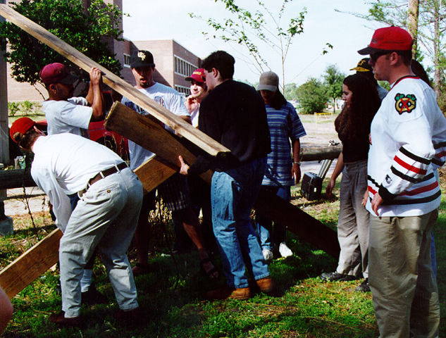
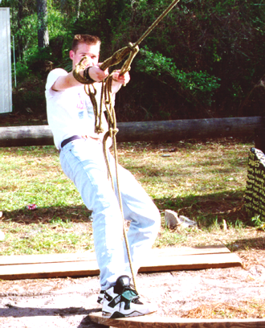
Behavioral theories
There are behavioral determinants of leadership which can be learned.
People can be trained to be effective leaders.

Slide 42
Behavioral Theories Of Leadership
Behavioral theories of leadership
  Theories that attempt to isolate behaviors that differentiate effective leaders from ineffective leaders
  Behavioral studies focus on identifying critical behavioral determinants of leadership that, in turn, could be used to train people to become leaders.

Slide 43
Behavioral Theories
  University of Iowa Studies - Kurt Lewin
    explored three leadership styles
      autocratic - leader dictated work methods
      democratic - involved employees in decision making
        used feedback to coach employees
      laissez-faire - gave the group complete freedom
    results were mixed with respect to performance
      satisfaction higher with democratic leader

Slide 44
Behavioral Theories (cont..)
  Ohio State Studies - identified two dimensions of leadership
    initiating structure - extent to which a leader was likely to define and structure her/his role and the roles of group members to seek goal attainment
    consideration - extent to which a leader had job relationships characterized by mutual trust and respect for group members’ ideas and feelings
    findings - high-high leaders achieved high group task performance and satisfaction
      however, high-high was not always effective

Slide 45
Behavioral Theories (cont.)
  University of Michigan Studies - identified two dimensions of leadership
    employee oriented - emphasized interpersonal relationships
      accepts individual differences among subordinates
      associated with high group productivity
    production oriented - emphasized the technical or task aspects of the job
      concerned with accomplishing the group’s tasks
      associated with low group productivity and low job satisfaction

Slide 46
Behavioral Theories (cont.)
  Managerial Grid - two-dimensional grid that provides a framework for conceptualizing leadership style
    dimensions are concern for people and concern for production
    five management styles described
      impoverished (1,1) - minimum effort to reach goals and sustain organization membership
      task (9,1) - arrange operations to be efficient with minimum human involvement
      middle-of-the-road (5,5) - adequate performance by balancing work and human concerns

Slide 47
Managerial Grid (cont.)
  five management styles described (cont.)
    country club (1,9) - attention to human needs and creation of comfortable work environment
    team (9,9) - committed people motivated by a common purpose, trust, and mutual respect
  concluded that managers should use (9,9) style

Slide 48
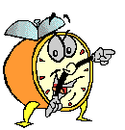
Let’s stop it here

Slide 49
Next….

Slide 50
Organizational Behavior
(MGT-502)
Lecture-22

